Slide 1
Time Series Analysis
Basics of Time Series Analysis
Nicoleta Serban, Ph.D.
Associate Professor
Stewart School of Industrial and Systems Engineering
The Concept of Stationarity: Data Example

Slide 2
About this lesson

Slide 3
Data Example: Temperature in Atlanta, Georgia
Data: Average monthly temperature records starting in 1879 until 2016.
Available from the iWearherNet.com
The Weather Bureau (now the National Weather Service) began keeping weather records for Atlanta 138 years, 8 months and 19 days ago on October 1, 1878.
Provided in Fahrenheit degrees
Is there seasonality and trend in temperature in Atlanta? Is the residual process after removing seasonality and trend stationary?

Slide 4
Time Series Analysis: General Approach
1. Plot the series and check for
a. trend
b. a seasonal component
c. any apparent sharp changes in behavior
d. any outlying observations
2. Remove trend and seasonal components to get stationary residuals.
3. Choose a model to fit the residual process.
4. Forecasting can be carried out by forecasting residuals and then inverting the transformations carried out in Step 2.2.

Slide 5
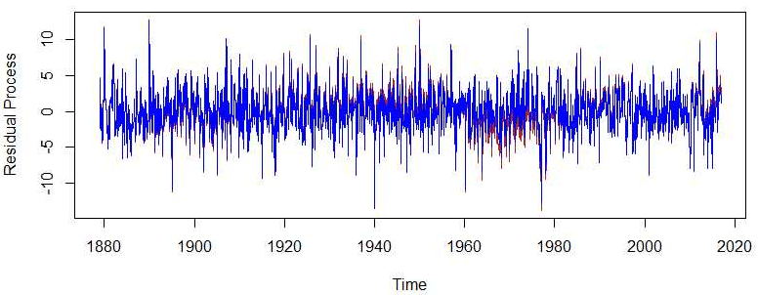
Residual Process

Slide 6
Sample Autocorrelation Functions
## ACF for the temperature time series
acf(temp,lag.max=12*4,main="")
## ACF for the residual process
acf(dif.fit.lm,lag.max=12*4,main="")
acf(dif.fit.gam,lag.max=12*4,main="")

Slide 7
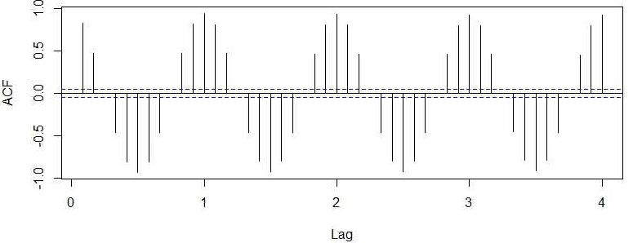
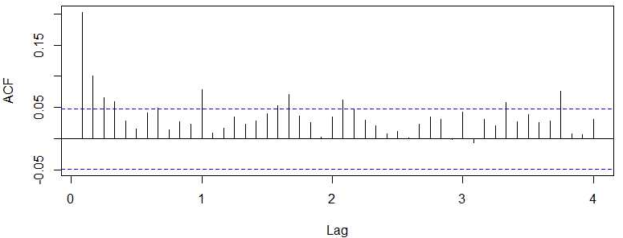
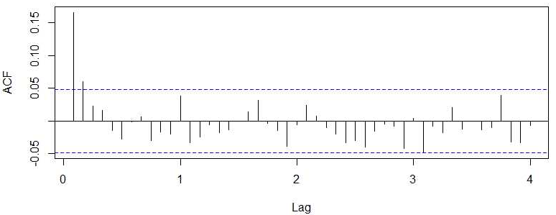
Sample Autocorrelation Functions
There is a clear seasonality pattern; trend cannot be identified since it is slowly changing over years
No seasonality pattern but some cyclical pattern mirroring the seasonal periodicity
No seasonality pattern; the residual process shows some stationarity

Slide 8
Summary

